Slide 1
NERVE MUSCLE PHYSIOLOGY
DR JAGDISH NARAYAN
ASSISTANT PROFESSOR
DEPARTMENT OF PHYSIOLOGY

Slide 2
LECTURE 1
INTRODUCTION
STRUCTURE & FUNCTION OF NEURON
MYELINOGENESIS

Slide 3
Introduction
Human CNS contain >100 billion neurons
50-100 times this number glial cells
About 40% human genes participating its formation
Specialized function of muscle – contraction
Specialized function of neurons – integration & transmission of nerve impulse
Along with endocrine, nervous system forms the major control system for body functions

Slide 4
NERVOUS SYSTEM
CENTRAL NERVOUS SYSTEM
PERIPHERAL NERVOUS SYSTEM
Brain
Spinal Cord
Autonomic nervous system
Somatic nervous system
Sympathetic nervous system
Parasympathetic nervous system

Slide 5
Neuron
Structural and functional unit of nervous system
Similar to other cell in body having nucleus and most organelles in cytoplasm
Different from other cells:
  Neurons has branches or processes- dendrites and Axon
  Have nissl granules and neurofibrillae
  No centrosome- loss power of division
  Contain and secrete neurotransmitter

Slide 6
Classification of Neuron
Depending upon the number of poles
Depending upon the function
Depending upon the length of axon

Slide 7
1. Depending upon the number of poles
a. Unipolar:
Having only one pole
From single pole both axon and dendrites arise
Present in embryonic stage in human being
b. Bipolar:
Having two poles
Axon arises one pole and dendrites other pole
c. Multipolar:
Nucleus having multipoles
Axon arise one pole & all other pole give rise dendrites

Slide 8
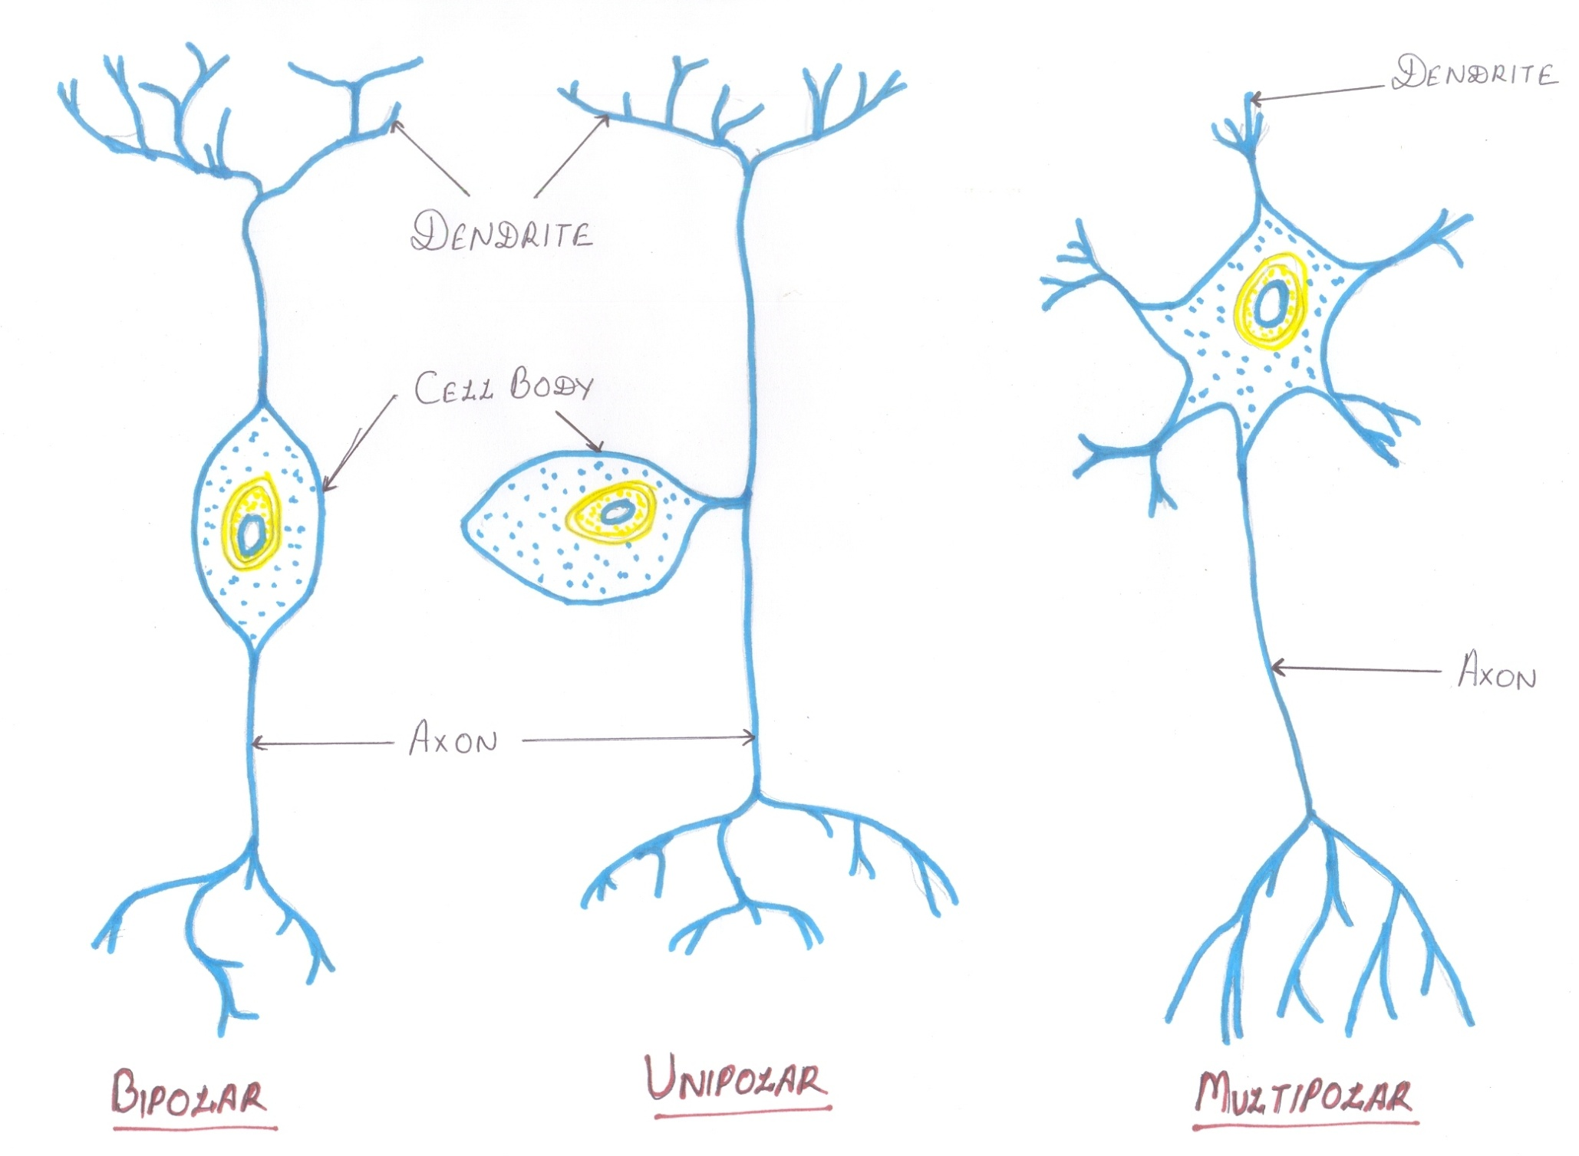

Slide 9
2. Depending upon the functions
Motor or efferent neurons:
  Carry impulses from CNS to peripheral effector organs e.g., muscles/glands/blood vessels
  Generally each motor neurons has long axon and short dendrites
Sensory or afferent neurons:
  Carry impulses from periphery to CNS
  Generally each neuron has short axon a long dendrites

Slide 10
3. Depending upon the length of axon
Golgi Type I neurons:
  Have long axons
  Cell body situated in CNS and their axon reaches remote peripheral organs
Golgi type II neurons:
  Have short axons
  Present in cerebral cortex and spinal cord

Slide 11
Structure of Neuron
Structural and functional unit of nervous system
Consists of nerve cell body with all its processes axon and dendrites
All neurons contain one and only one axon
But dendrites may be absent one or many
Axon carries impulses from the soma towards a centrifugal directions (away from soma)
Dendrites brings impulse from distance centripetally (towards the soma)
Nerve cell means a neuron where as nerve cell body means soma

Slide 12
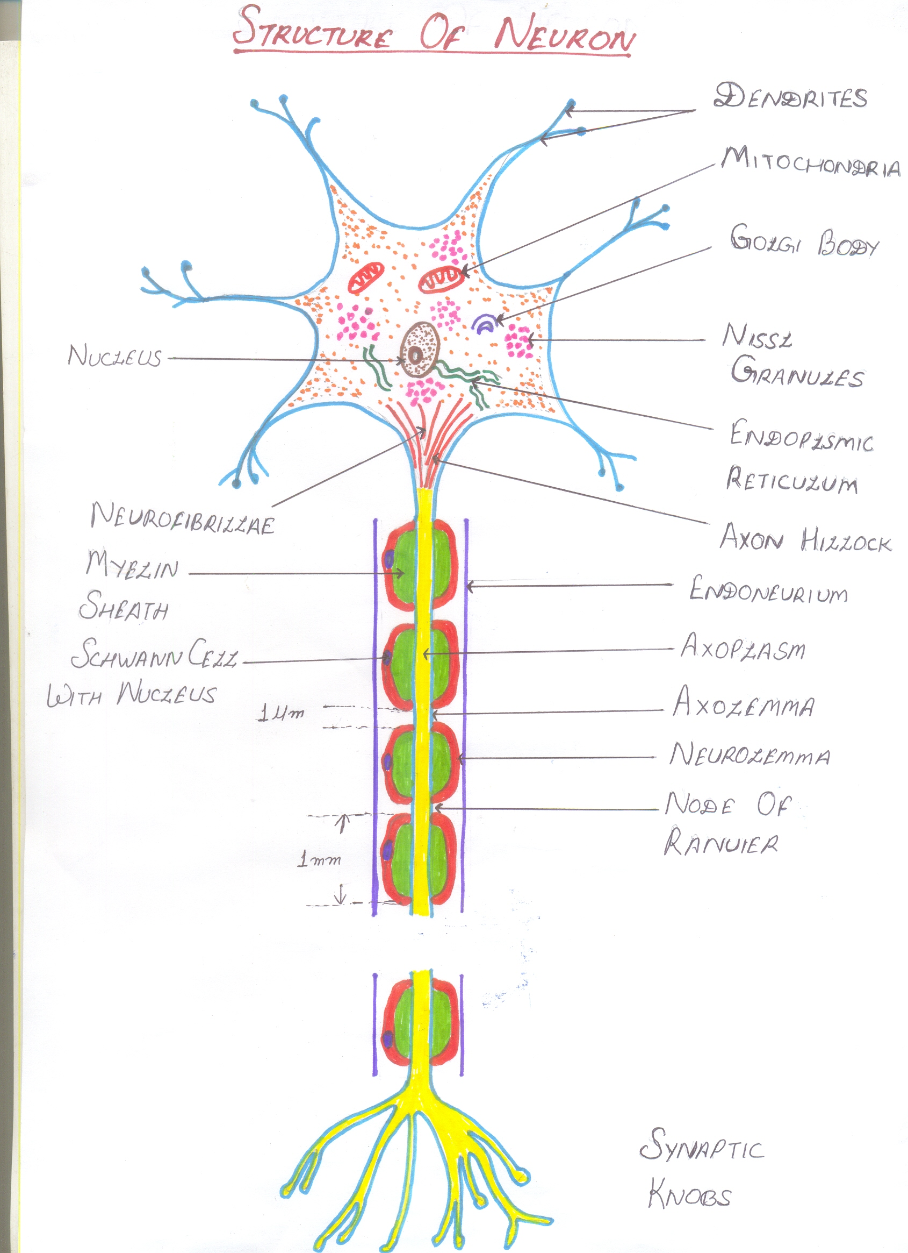

Slide 13
Neuron can be divided in to:
  Cell body (nerve cell body)
  Dendrites
  Axon
  Nerve terminals

Slide 14
i. Nerve cell body:
AKA soma, perikaryon
Various size and forms – stellate, round, pyramidal
It maintains the functional and anatomical integrity of axon cut part distal to cut degenerate
Cytoplasm contains:
  Nucleus
  Nissl bodies or Nissl granules
  Neurofibrillae
  Mitochondria
  Golgi apparatus
Nissl granules and neurofibrillae found only in nerve cell not in other cells

Slide 15
CONTI
Soma are present in :
  - Grey matter of CNS
  - Nuclei of brain e.g., cranial N. Nuclei/Basal ganglia/Ganglia of CNS
  - All neurons contain soma
  - All processes do not survive without soma

Slide 16
CONTI
i. Nucleus:
  Each neuron has centrally placed one nucleus in soma
  Prominent nucleoli which contains ribose nucleic acid
  No centrosome – loss power of division

Slide 17
CONTI
ii. Nissl granules or bodies:
  Named after discoverer FRANZ NISSL in 19th century
  Also called tigroid substance (spotted appearance when properly stained)
  Small basophilic granules or membrane bound cavities found in clusters or clumps in soma
  Present in cell body and dendrites but absent in axon and axon hillock

Slide 18
CONTI
  Composed of ribonucleoprotein (RNA + Protein) Ribosome= RNA+ protein
  Synthesize proteins of neurons which transported to axon by axonal flow
  When demand of protein synthesis great nissl granules over work and may altogether disappear (chromatolysis) e.g, fatigue, anoxic, injured
  Reappear following recovery of neurons from fatigue or after regeneration

Slide 19
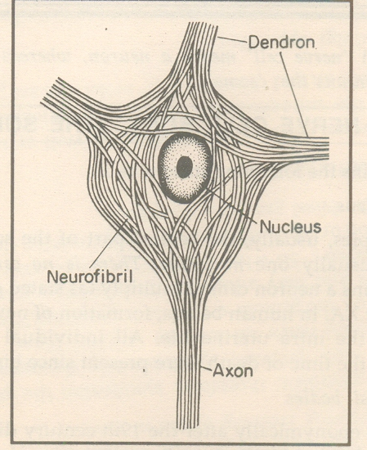
CONTI
Neurofibrillae (Microtubules & microfilaments):
  Thread like structure present all over cell
  Consists of microtubules and microfilament
Mitochondria:
  Present in soma and axon
  Form the power house of the nerve cell where ATP produced
Golgi Apparatus
  Same of Golgi Apparatus other cells
  Concerned with processing and packing of proteins into granules

Slide 20
DENDRITES:
Tapering and branching extension of soma
Dendrites of cerebral cortex and cerebellar cortex show knobby projections called dendritic spine
May be absent if present may be one or many in number
Conduct impulses towards the cell body
Generate local potential not action potential as well as integrate activity
Has Nissl granules and neurofibrils
Dendrites and soma constitute input zone

Slide 21
Axon
Each axon has only one axon
Arises from axon hillock of soma
Carry impulses away from cell body
Cannot synthesize own protein depends upon soma
Branched only at its terminal end called synaptic knobe, terminal button, axon telodendria

Slide 22
CONTI
Axon may be medullary or non medullary
Synaptic knobs Terminal buttons or Axon Telodendria
Axon divides into terminal branches and each ending in numbers of synaptic knobs
Contain granules or vesicles which contain synaptic transmittors
Specialized to convert electrical signal (AP) to chemical signal

Slide 23
Axis cylinder
Has long central core of cytoplasm- axoplasm
Axoplasm covered by membrane – axolemma continuation of cell membrane of soma
Axoplasm along with axolemma- axis cylinder
Contain mitochondria, neurofibrils and axoplasm, vesicles
Axis cylinder covered by neurilemma in non myelinated nerve fiber
Nerve fiber insulated by myelin sheath – myelinated nerve fiber

Slide 24
Myelin Sheath
Concentric layers of protein alternating with lipid
Nerve fiber insulated by myelin sheath- myelinated nerve fiber
Protein lipid complex wrapped around axon >100 times
Outside the CNS (peripheral nerve) myelin produced by Schwann cells
Inside the CNS myelin sheath produced by oligodendrogliocytes

Slide 25
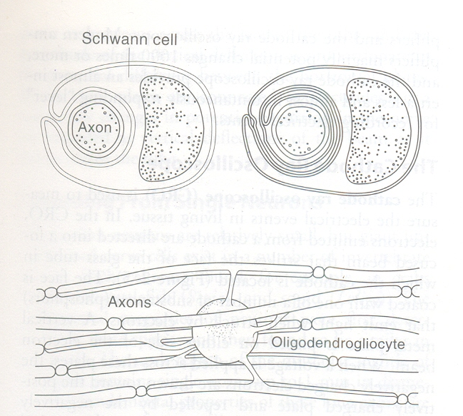

Slide 26
CONTI
Myelin is compacted when extracellular membrane protein (Po) locked extracellular portion of Po apposing membrane
Not continuous sheath absent at regular intervals
Where sheath absent – node of Ranvier (1µm)
Segment between two node- internode (1mm)

Slide 27
Myelinogenesis
Formation of myelin sheath around the axon
Peripheral nerve started 4th month of IUL and completed few years after birth
Pyramidal tract remain unmyelinated at birth and completed around end of 2nd year of life
Outside its CNS myelin sheath formed by Schwann cells
Before myelinogenesis Schwann cells (Double layer) close to axolemma as in non myelinated nerve fiber

Slide 28
CONTI
Membrane of Schwann cells wrappe up and rotate around the axon many concentric layer but not cytoplasm
These concentric layer compacted – produce myelin sheath
Cytoplasm of cell not deposited in myelin sheath
Nucleus of cell remain in between myelin sheath and neurilemma
Myelinogenosis in CNS occurs by oligodendrogeocytes

Slide 29
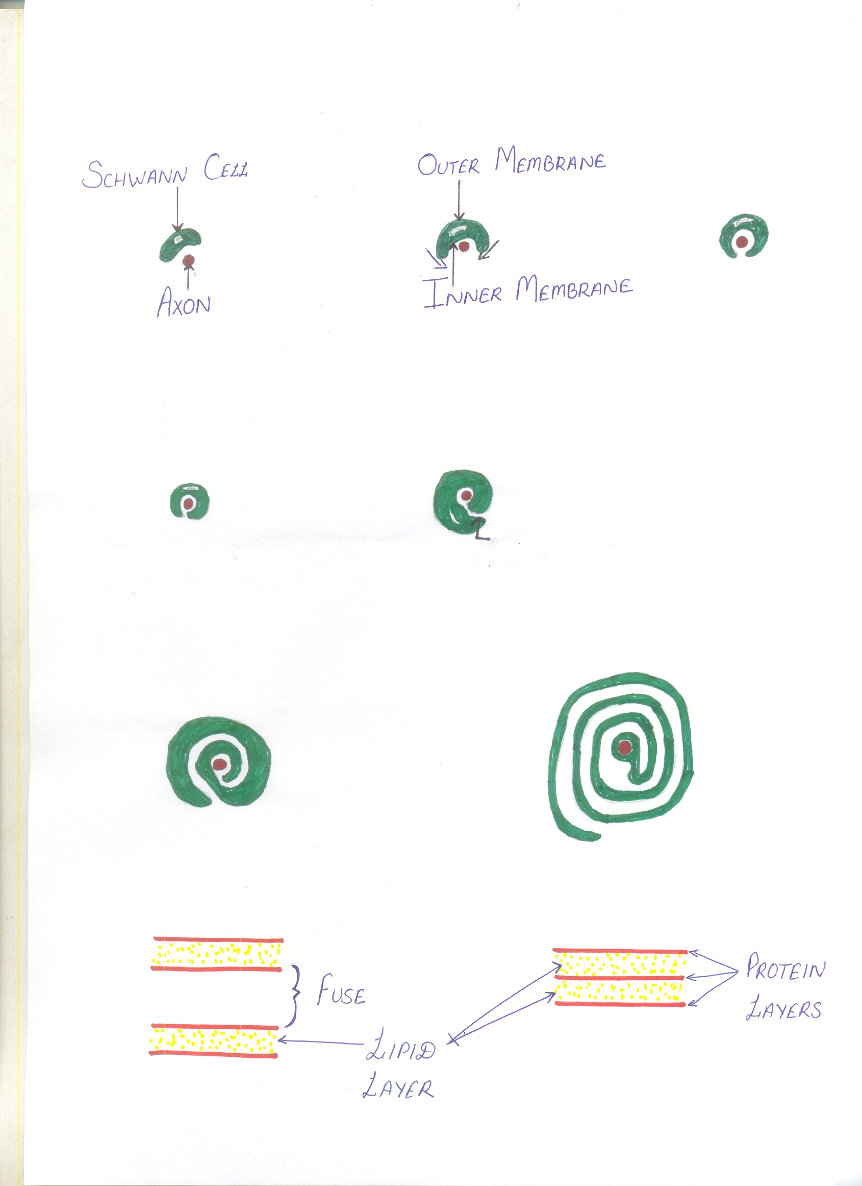

Slide 30
Non myelinated nerve
No myelin sheath formation
Nerve fiber simply covered by Schwann cells, no wrapping
No internode and node of Ranvier
Neurilemma and axis cylinder close to each other
In CNS no neurilemma
Myelinogenosis in CNS by oligodenogliocytes not by Schwann cells

Slide 31
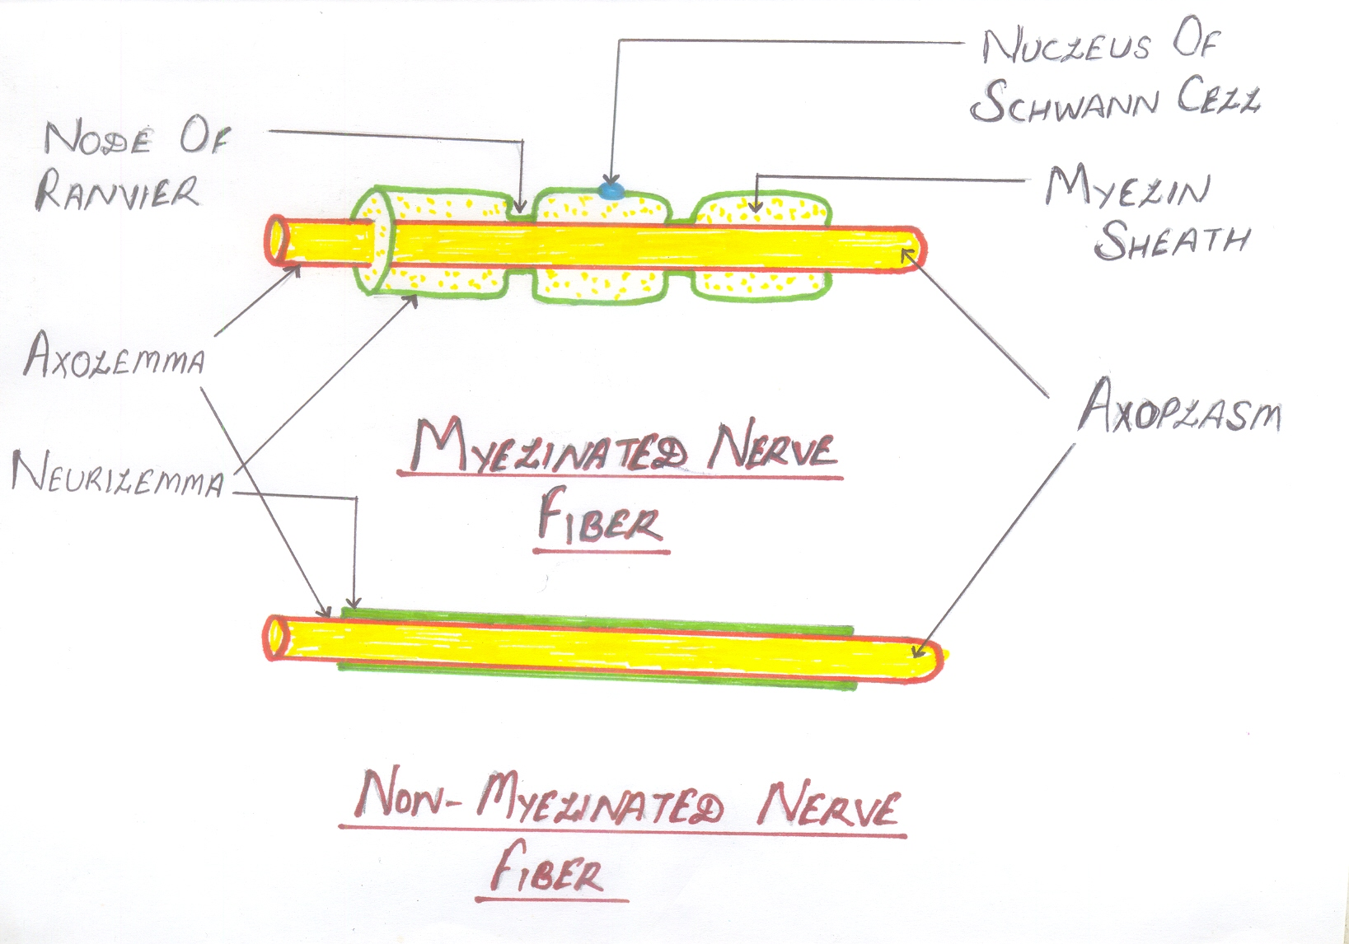

Slide 32
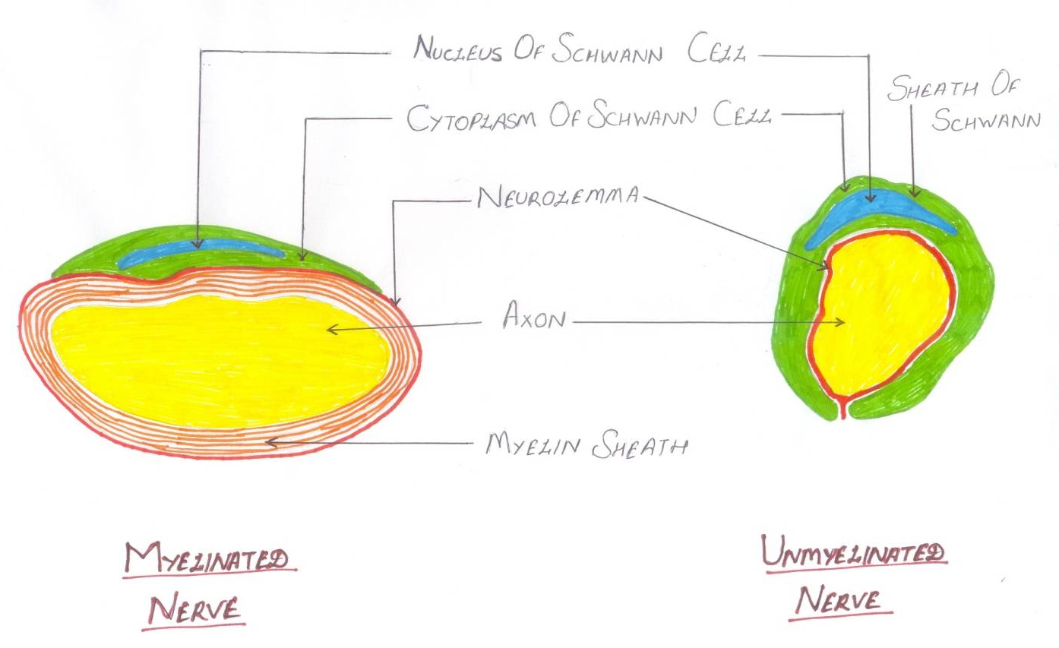
Importance and Myelin Sheath
Propagation of AP very fast d/t saltatory conduction (possible only in myelinated nerve fiber)
Myelination results quicker mobility in higher animals
Have high insulating capacity so prevents cross stimulation

Slide 33
Neurilemma
AKA sheath of schwann
This membrane which surrounds axis cylinder
Contain schwann cells which have flattend and elongated nuclei
One nucleus is present in each internode of axon
Nucleus situated between myelin sheath and neurilemma
Non myelinated nerve fiber neurilemma surrounds axolemma continuously
At node of ranvier neurilemma invaginates upto axolemma

Slide 34
Functions of Neurilemma
Non myelinated nerve fiber – serve as covering membrane
In myelinated nerve fiber necessory for myelinogenesis
Neurilemma absent in CNS
Oligodendrogliocytes are responsible for myelinogenesis in CNS

Slide 35
FUNCTIONAL DIVISION OF NEURON
Divided in to four zone:
1. Receptor or dendritic zone:
  Multiple local potential generated by synaptic connection are integrated
2. Origin of conducted impulse:
  Propagated action potential generated (Initial of segment of spinal motor neuron)
  Initial node of Ranvier in sensory neuron

Slide 36
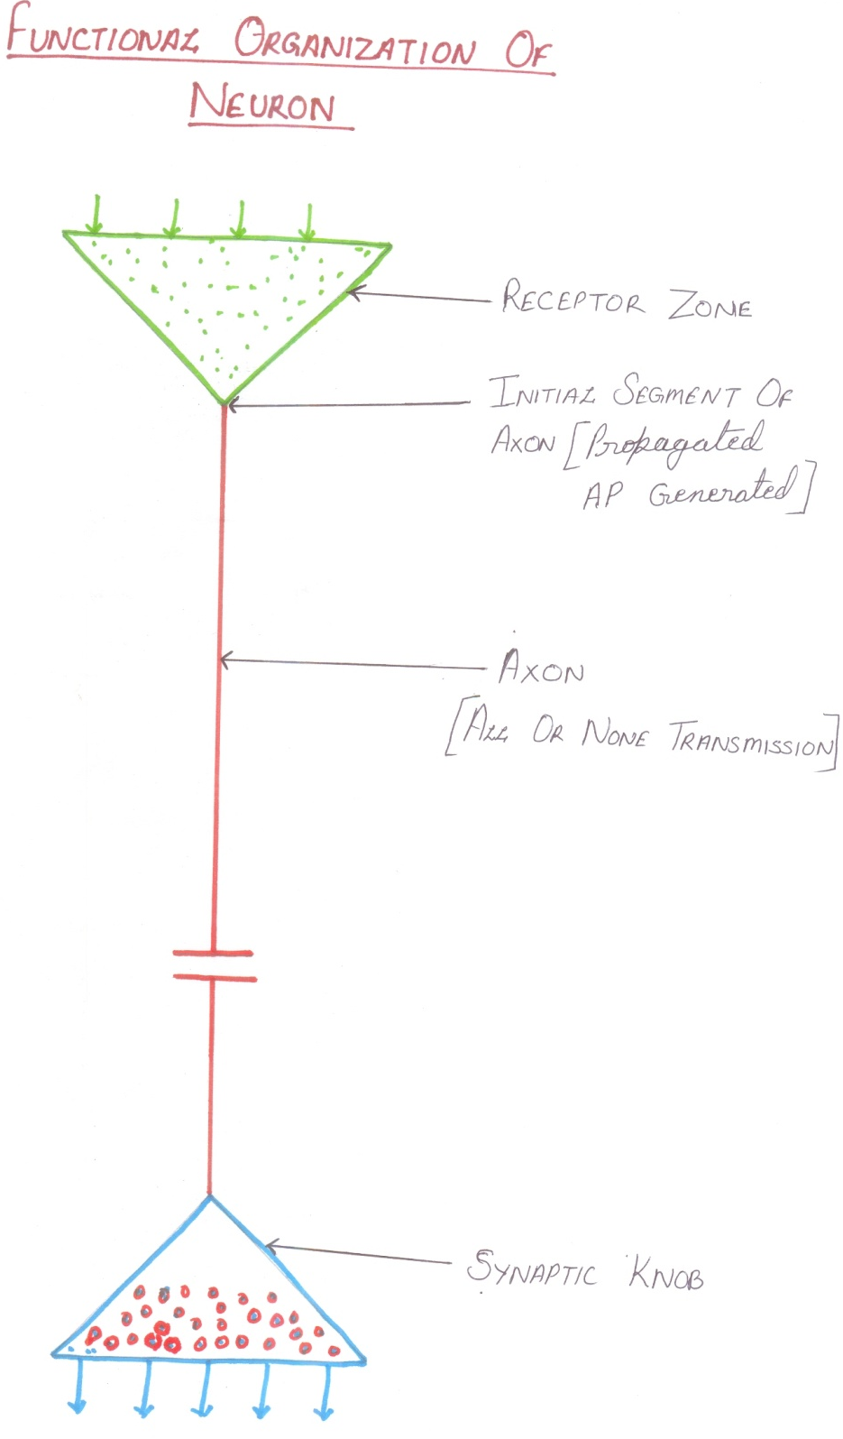
3. Conductive zone:
  Axonal process transmits
  Propogated impulse to the
  nerve ending
  All or none transmission
4. Secretory zone:
  Nerve ending where AP
  cause release of
  neurotransmitters

Slide 37
Axonal Transport
Transport sub^{s} from soma to synaptic ending
Fast axonal transport- Membrane bound organelles & mitochondria ( 400 mm/ day)
Slow axonal transport- Sub^{s} dissolved in cytoplasm-Proteins (1mm/ day)
Requires ATP/ Ca⁺⁺ & microtubules for guide
Occurs in both direction anterograde & retrograde
Anterograde transport- Synaptic vesicles/ proteins
Retrograde transport- Neurotrophins /viruses

Slide 38
Question 1
Nissl bodies are composed of
DNA
RNA with protein
Lipoprotein
Fine granules composed of uracil

Slide 39
Question 2
Development of myelin sheath in peripheral nervous system depends on
Astrocytes
Microglia
Oligodendrocytes
Schwann cells

Slide 40
Question 3
All or None phenomenon in a nerve is applicable to
Mixed nerve
Only a sensory nerve
Only a motor nerve
A single nerve fiber

Slide 41
Question 4
Which of the following may show antidromic conduction
Synapse
Axons
Both a & b
Cell body

Slide 42
Question 5
Myelin is
Usually ensheaths the axon hillock
Usually forms an uninterrupted coating around axons
Cover the dendrites, cell bodies and axon endings
Is found in greater concentration in the white matter of the spinal cord then in the grey matter

Slide 43
Lecture 2
Neurotrophins
Glial cells (Neuroglia)
Classification of nerve fiber

Slide 44
Neurotrophins – Neurotrophic Factors
Protein substances
Play important role in growth and functioning of nervous tissue
Secreted by many tissue in body e.g., muscles/ neurons/ astrocytes
Functions:
  Facilitate initial growth and development of nerve cells in CNS & PNS

Slide 45
CONTI
Promote survival and repair of nerve cell
Maintenance of nerve tissue and neural transmission
Recently – neurotrophins capable of making damaged neuron regrow
Used reversing devastating symptoms of nervous disorders like Parkinson disease, Alzheimer's disease,
Commercial preparation for treatment of some neural diseases

Slide 46
Type
1st protein identified as neurotrophin- nerve growth factor (NGF)
Now many numbers neurotrophin identified
1. Nerve growth factors (NGF)
  Promote early growth and development in neurons
  Major action on sympathetic and sensory neurons especially neurons concerned with pain
  AKA sympathetic NGF (major actions on sympathetic neurons

Slide 47
CONTI
Commercial preparation of NGF extracted from snake venoms and submaxillary gland of male mouse
Used in sympathetic neurons disease as well as many neurons disorders:
  Alzeimer’s disease
  Neuron degeneration in aging

Slide 48
Other Neurotrophins:
2. Brain derived neurotrophic growth factor (BDGF)
1st discovered in pig brain now found in human brain and sperm
Promotes survival of sensory and motor neurons
Enhances growth of cholinergic, dopaminergic neurons and optic nerve
Also regulate synaptic transmission
Commercial preparation used to treat motor neuron disease

Slide 49
CONTI
3. Ciliary Neurotrophic factor (CNTF)
Found in neurological cells/ astrocytes and Schwann cells
Potent protective action on dopaminergic neurons
Used for treatment of Parkinson’s disease
4. Fibroblast growth factors:
Promoting fibroblastic growth

Slide 50
CONTI
5. Glial cell line- derived neurotrophic factor (GDNF)
  Maintains mid bran dopaminergic neurons
6. Leukemia inhibitory factors (LIF)
  Enhances the growth of neurons
7. Insulin like growth factor I (IGF-I)
8. Transforming growth factor
9. Fibroblast growth factor
10. Platelet – derived growth factors

Slide 51
Neurotrophin 3 (NT-3)
Act on motor sympathetic and sensory organs neurons
Regulates release of neurotransmitter from NMJ
Useful for treatment of motor neuron neuropathy and diabetic neuropathy
Others sub belong to neurotrophin family NT-4, NT-5 α leukemia inhibitory factors
NT-4 & NT-5 act on sympathetic and sensory and motor neurons

Slide 52
Neuroglia
Neuroglia or glia (glia- glue) supporting cells of nervous system
Non excitable and do not transmit nerve impulse
10-50 time as many glial cells as neurons
Capable of multiplying by mitosis
Schwann cells invest axon also glial cells

Slide 53
Classification of Neuroglial cells
1. Central Neuroglial cells
  Astrocytes:
      Fibrous astrocytes
      Protoplasmic astrocytes
  Microglia
  Oligodendrocytes
2. Peripheral neuroglial cells
  Schwann cells
  Satellite cells

Slide 54
Astrocytes:
Star shaped found throughout the brain joining to blood vessels
Investing synaptic structures neuronal bodies and neuronal process
Two types:
  i. Fibrous astrocytes
  ii. Protoplasmic Astrocytes:

Slide 55
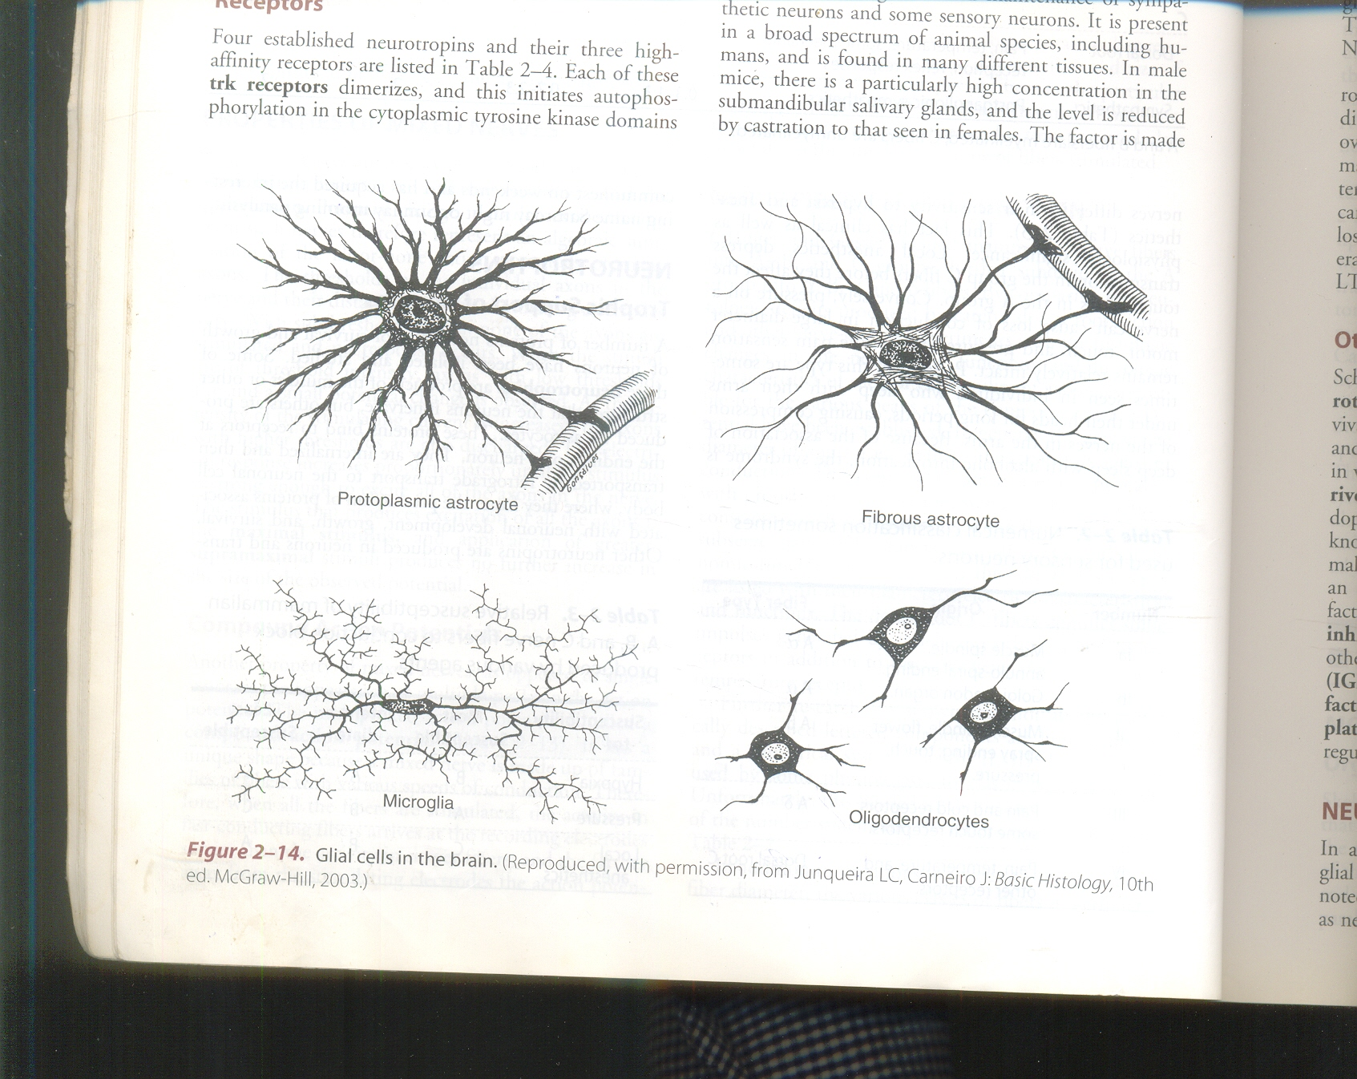
CONTI
i. Fibrous astrocytes
Found mainly in white matter
Process of cells cover nerve cells and synapses
Play important role in formation of blood brain barrier by sending process to blood vessels of brain

Slide 56
ii. Protoplasmic Astrocytes:
Present mainly in grey matter
Process of neuroglia run between nerve cell bodies
Functions:
  Form blood brain barrier so regulate the entry of sub^{s} from blood to brain tissue
  Twist around the nerve cells and form supporting network in brain and spinal cord
  Maintain chemical environment of ECF around CNS neurons
  Provides Ca+ and potassium and regulate neurotransmitter level in synapses
  Regulate recycling and neurotransmitter during synaptic transmission

Slide 58
Microglia
Derived from monocytes and enter the CNS from blood
Phagocytic cells migrate to the site of infection or injury after called macrophages of CNS
Smallest neuroglial cells
Functions:
Engulf and destroy microorganism and cells as debris
Migrate to injured or infected area of CNS and act as mature macrophages

Slide 59
Oligodendrocytes
Produced myelin sheath around nerve fiber in CNS
Nerve only few process which are short
Functions:
Provide myelination
Provide support to CNS neurons by forming semi still connective tissue between neurons

Slide 60
Peripheral neuroglial cells
1. Schwann cells:
Major glial cells in PNS
Play important role in nerve regeneration
Remove celluler debris during regeneration by their phagocytic activity

Slide 61
CONTI
2. Satellite cells:
Present on extensor surface of PNS neurons
Functions:
Provide physical support to PNS neurons
Help in regulation of chemical environment of ECF around PNS neurons

Slide 62
Classification of Nerve fiber
General features of nerve:
Greater the diameter of nerve fiber
  Greater speed of conduction
  Greater magnitude of spike potential
  Smaller duration of spike
  Lesser threshold of excitation

Slide 63
CONTI
Speed of conduction
Myelinated fibers
  Approximately 6 times fiber diameter
  Myelinated fiber diameter ranges from 1−20µ m
  Therefore conduction velocity varies from 6-120 mts/sec

Slide 64
Nonmyelinated fibers:
  Speed of conduction proportional to square root of diameter
  Largest unmyelinated fiber approxi 1µm in diameter
  Therefore max conduction velocity 1 mt/sec
Long axon mainly concerned with proprioceptive, pressure and touch sensation and somatic motor functions
Small axons concerned with pain and temp sensation and autonomic functions

Slide 65
Classification of Nerve fibers
1. Depending upon structure
  Myelinated nerve fibers
  Non myelinated nerve fibers
2. Depending upon distribution
  Somatic nerve fibers (supply skeletal muscles)
  Visceral or autonomic (supply internal organs)
Depending upon origin
  Cranial nerve (arising from brain)
  Spinal nerve (arising from spinal cord)

Slide 66
Depending upon functions:
  Sensory nerve fibers (afferent nerve fiber)
  Motor nerve fibers (efferent nerve fibers)
Depending upon secretion of neurotransmitter
  Adrenergic nerve fibers
  Cholinergic nerve fibers
Depending upon diameter and conductions of impulse (Erlanger- gasser classification)
Classified into three major groups:
  Type A nerve fibers
  Type B nerve fibers
  Type C nerve fibers

Slide 67
Among these type A thickest fibers
Type c thinnest fibers
Except type C fibers all fibers are myelinated
Type A nerve fibers further subdivided four groups:
  Aα or Type I nerve fibers
  Aβ or Type II nerve fibers
  Aγ or Type III nerve fibers
  Aδ

Slide 68
Fiber type | Functions | Fiber diameter (µm) | Conduction velocity (mt/sec)
α | Proprioception, somatic motor | 12-20 | 70-120
β | Touch, pressure, motor | 5-12 | 30-70
γ | Motor to muscle spindles | 3-6 | 15-30
δ | Pain cold touch | 2-5 | 12-30
B | Preganglionic autonomic | <3 | 3-15
C | Pain temperature some mechanoreceptor | 0.4-1.2 | 0.5-2
Dorsal root | Reflex response
Sympathetic | Post ganglionic sympathetic | 0.3-1.3 | 0.7-2.3

Slide 69
Numerical classification
Number | Origin | Fiber type
Ia | Muscle spindle Annulo-spiral ending | Aα
Ib | Golgi Tendon organ | Aα
II | Muscle spindle flower spray ending, Touch, Pressure | Aβ
III | Pain and cold receptor some touch receptors | Aδ
IV | Pain, Temp and other receptors | Dorsal roots

Slide 70
Physio-clinical classification
Susceptibility | Most susceptible | Intermediate | Least suitable
Hypoxia | B | A | C
Pressure | A | B | C
Local Anesthesia | C | B | A

Slide 71
Question 1
Which is not a CNS glial cell
Schwann cell
Microglia
Astrocyte
Oligodendroglia

Slide 72
Question 2
The most susceptible nerve fiber to local anesthetics
C type fiber
B type fiber
Parasympathetic
A type Fiber

Slide 73
Question 3
The conduction velocity in a myelinated fiber is directly related to
The amount of axon branching
Length of the fiber
Diameter of the fiber
Diameter of the dendrites

Slide 74
Question 4
Non-myelinated fiber differ from myelinated once in that they
Lack nodes of ranvier
Are more excitable
Have higher conduction velocity
Are not associated with schwann cells

Slide 75
Question 5
Not true of an astrocyte
Found throughout the brain joined to the blood vessels
Help forming blood brain barrier
Forms myelin around the axons within CNS
Helps in maintaining optimal conc^{n} of ions in the brain neurons

